Slide 1

Dual-Mode Real-Time Cap Sorting System Using Arduino Uno
Navarro, Rod Geryk C.
CPE161P - 4 – C1

Slide 2
INTRODUCTION
This project focuses on developing a real-time sorting machine using an Arduino Uno to automate the classification of plastic bottle caps based on their color. The machine operates in two modes: automatic and manual. In automatic mode, the system independently sorts caps using a color sensor and servo motors, while in manual mode, users can control the sorting process through a 4x4 keypad making the machine suitable for educational demonstrations on automation and embedded systems.. An LCD display keeps track of the number of caps sorted for each color, providing real-time feedback on the system’s performance. By integrating various hardware components such as servo motors, a color sensor, an LCD display, and a keypad with Arduino programming, this project creates an efficient and flexible solution for small-scale recycling efforts.

Slide 3
OBJECTIVES
Develop a dual-mode sorting system
Create a sorting machine that can operate in two modes:
• Automatic Mode: Sorts caps automatically based on their color.
• Manual Mode: Allows the user to control sorting through a 4x4
keypad.
Integrate servo motors for sorting operations
Use two servo motors to:
• Pick caps from the storage and position them for color detection.
• Route the identified caps to their respective containers.
Implement color detection system
Use a color sensor to identify and sort three different colored caps
accurately.
Display sorting information on an LCD
Show the number of caps sorted per color on an LCD screen in real time.
Ensure smooth user interaction
Allow users to easily switch between automatic and manual modes
at the start using the keypad.
Achieve efficient and accurate sorting
Make sure the system sorts caps correctly and keeps track of the
count without errors.
Test and optimize system performance
Evaluate the system's speed, accuracy, and reliability in both
modes, and make improvements as needed.

Slide 4
DISCUSSION
The real-time sorting machine designed in this project efficiently categorizes plastic bottle caps based on their color using an Arduino Uno. It features two operational modes: automatic and manual. In automatic mode, the system independently picks, identifies, and sorts caps using servo motors and a color sensor, ensuring each cap is directed to the correct container. Meanwhile, the manual mode allows users to control the sorting process using a 4x4 keypad, offering greater flexibility. An LCD display tracks and displays the number of caps sorted by color in real-time, providing users with immediate feedback on the system’s performance.
By integrating hardware components such as servo motors, a color sensor, an LCD display, and a keypad, this project demonstrates the practical application of embedded systems in automation. The combination of mechanical and electronic elements with Arduino programming makes the sorting machine both efficient and adaptable for small-scale recycling operations or educational purposes.

Slide 5
MATERIALS
Arduino Uno the main microcontroller to control all components.
• 2 Servo Motors
• Color Sensor (e.g., TCS3200 or TCS34725) Identifies the color of
each cap.
• LCD Display (16x2) Displays the number of caps sorted per color.
• 4x4 Keypad Allows manual control of the sorting process.
• Colored Caps (3 Colors) The items to be sorted (red, green,
blue caps).
• Breadboard For circuit assembly and prototyping.
• Sorting Containers (3 Pieces) Separate containers for each color.
• Power Supply (5V or USB) To power the Arduino and components.
• Laptop with Arduino IDE For programming and uploading the
code

Slide 6
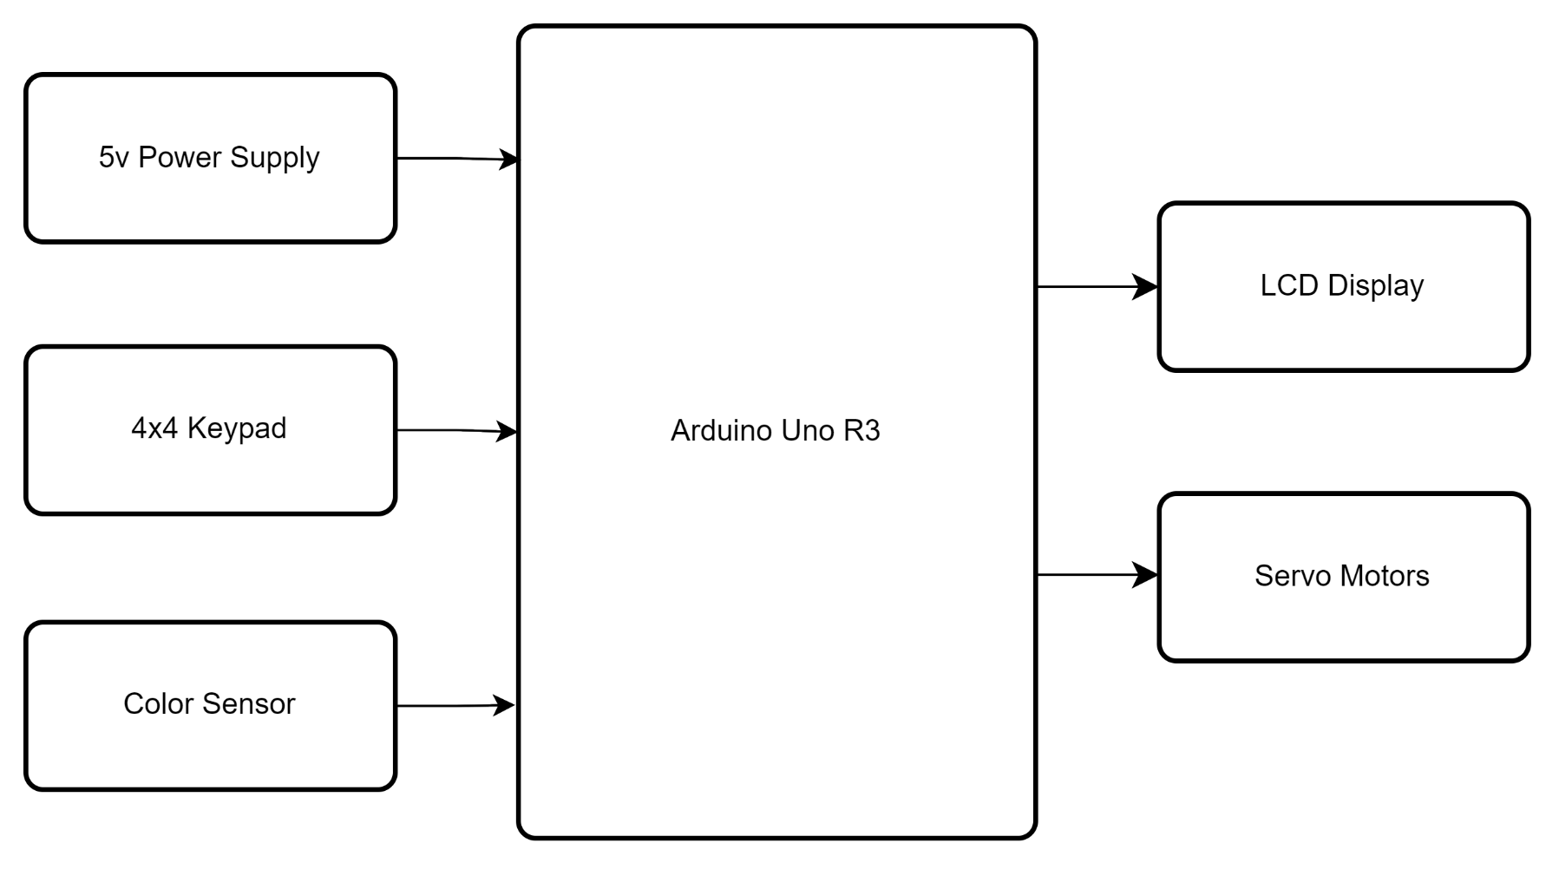
BLOCK DIAGRAM

Slide 7
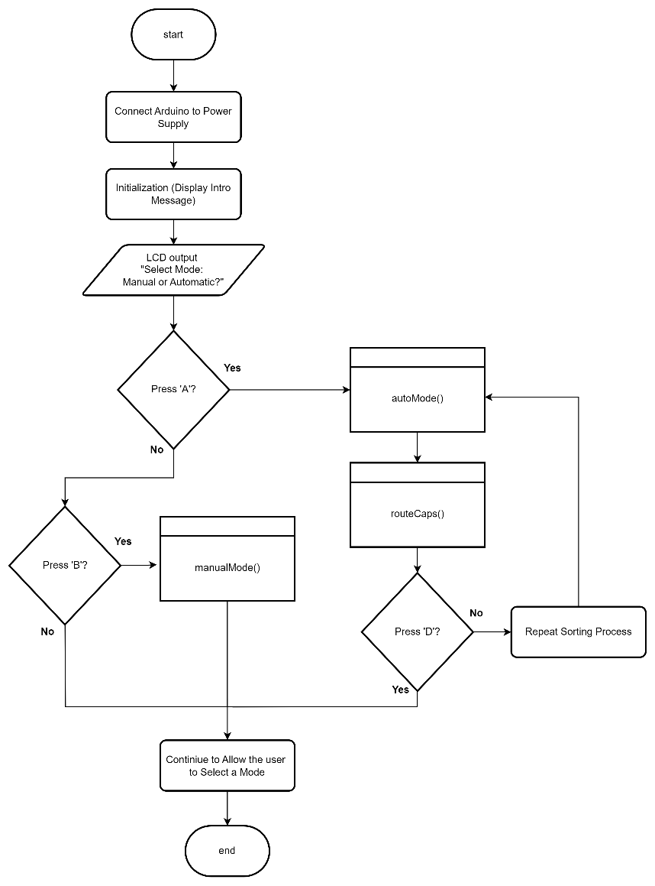
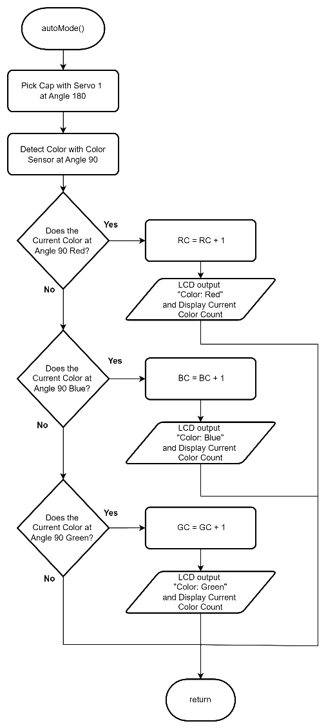
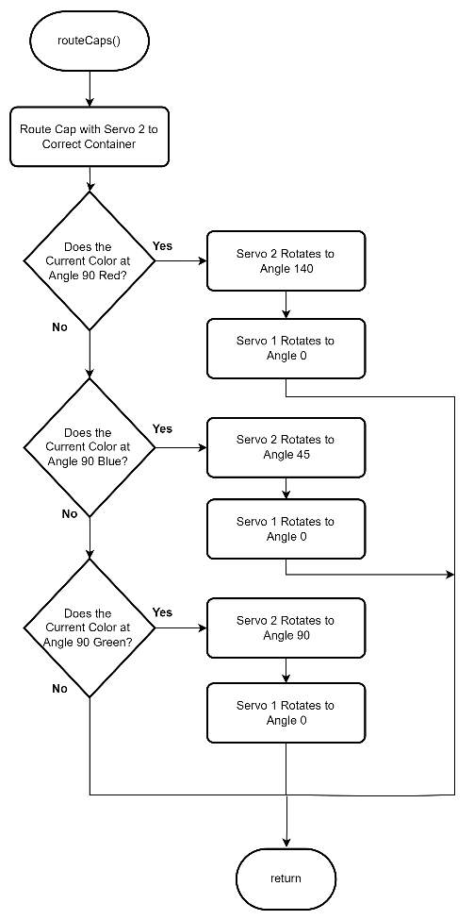
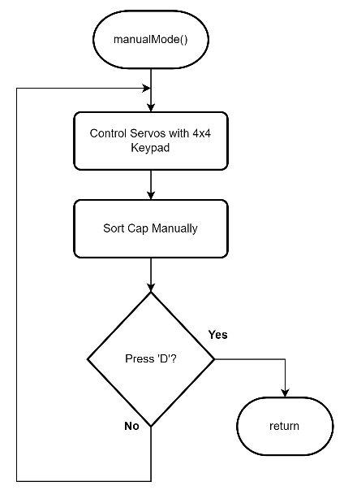
FLOWCHART

Slide 8
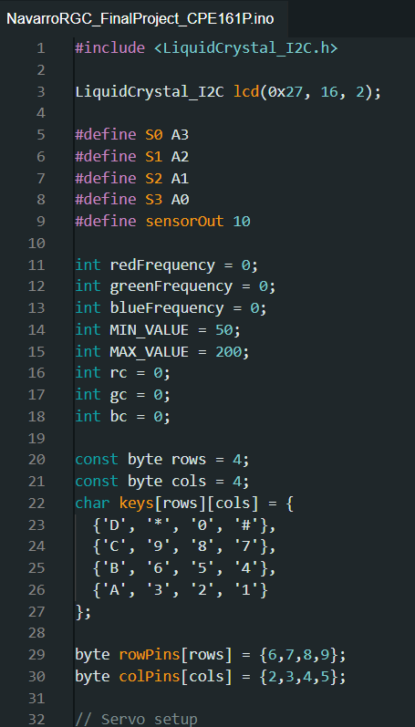
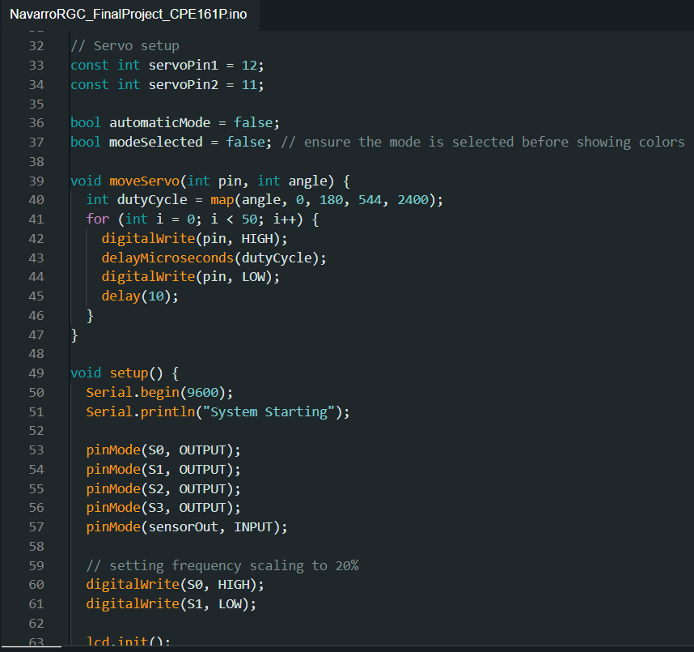
CODE

Slide 9
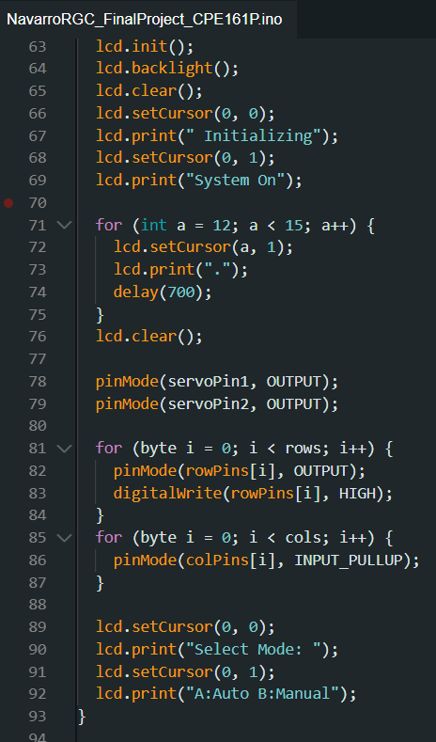
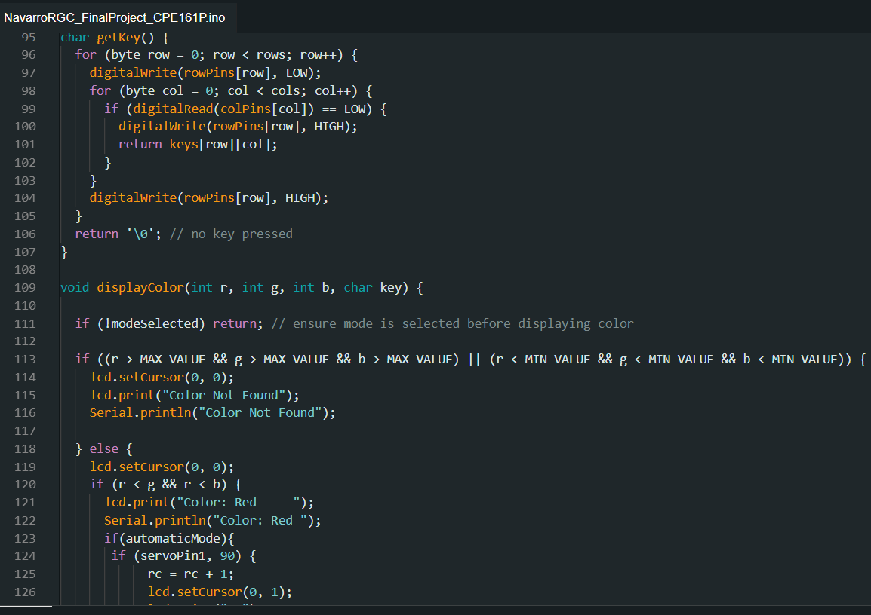
CODE

Slide 10
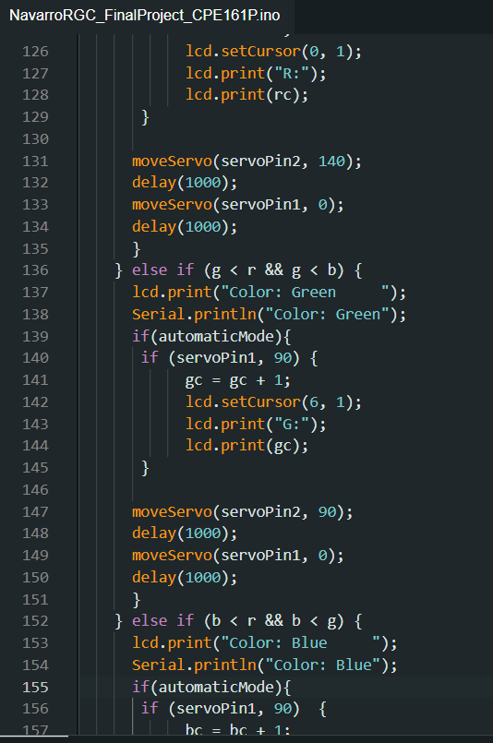
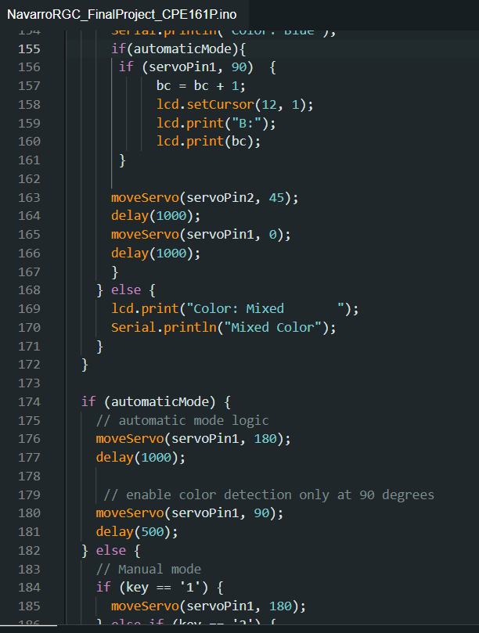
CODE

Slide 11
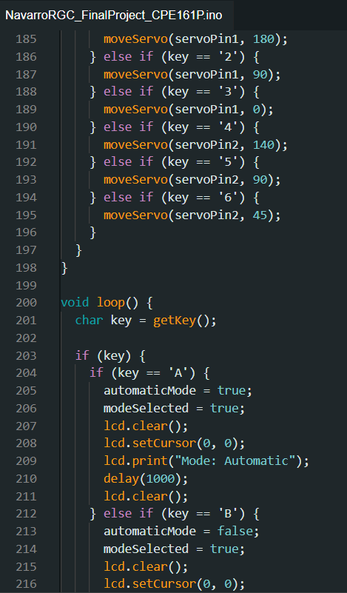
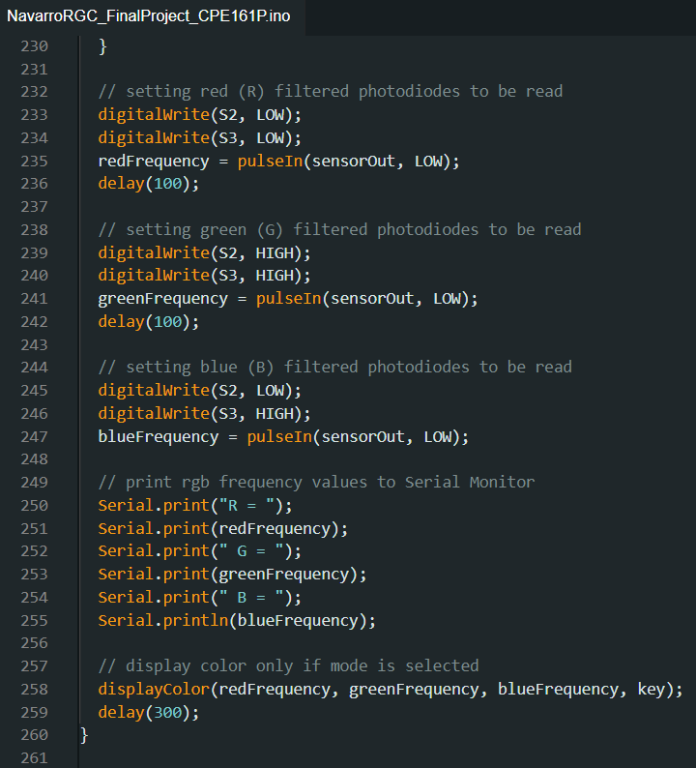
CODE

Slide 12
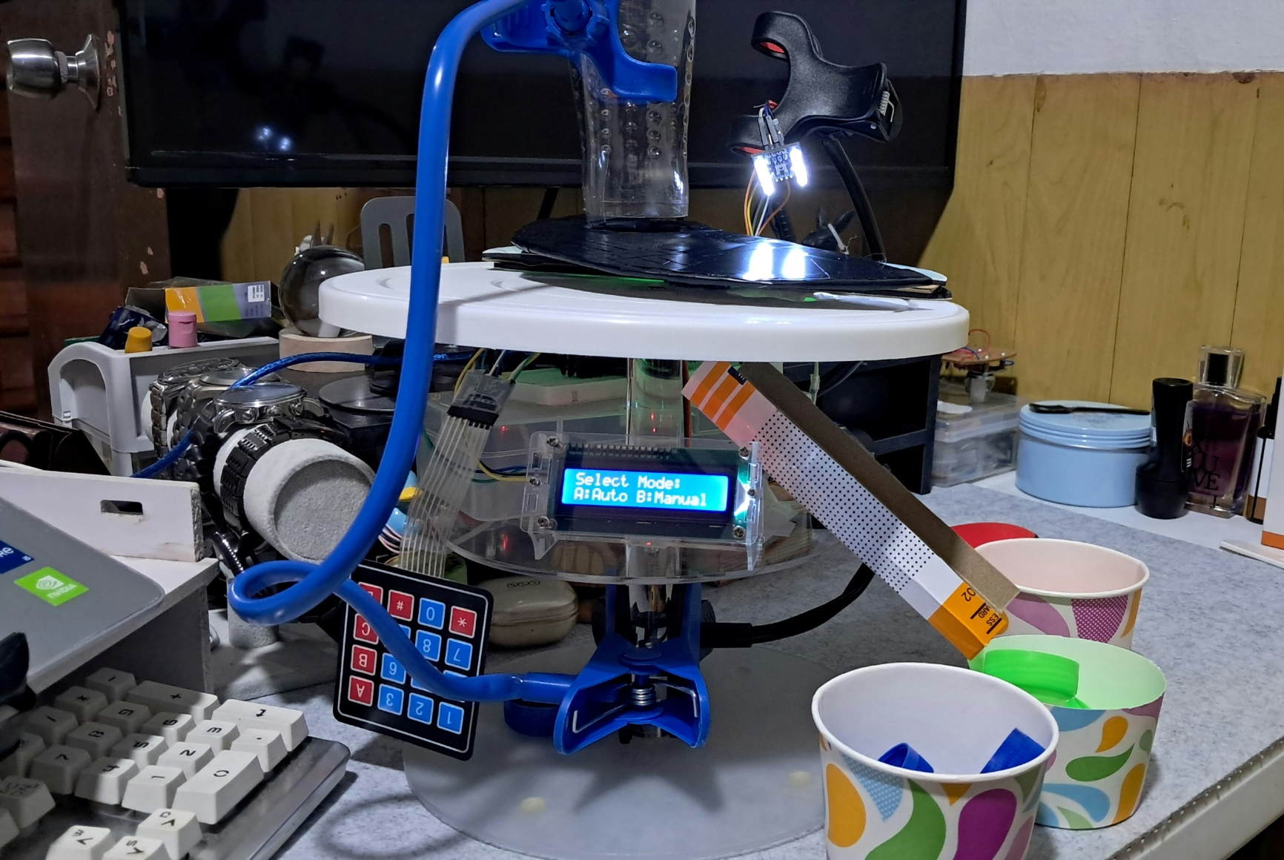
FINAL OUTPUT/PROTOTYPE DEMONSTRATION

Slide 13
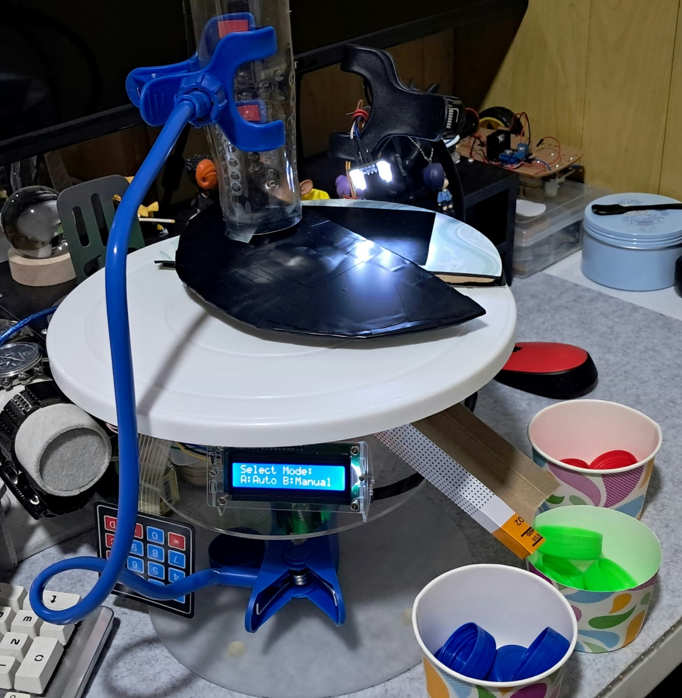
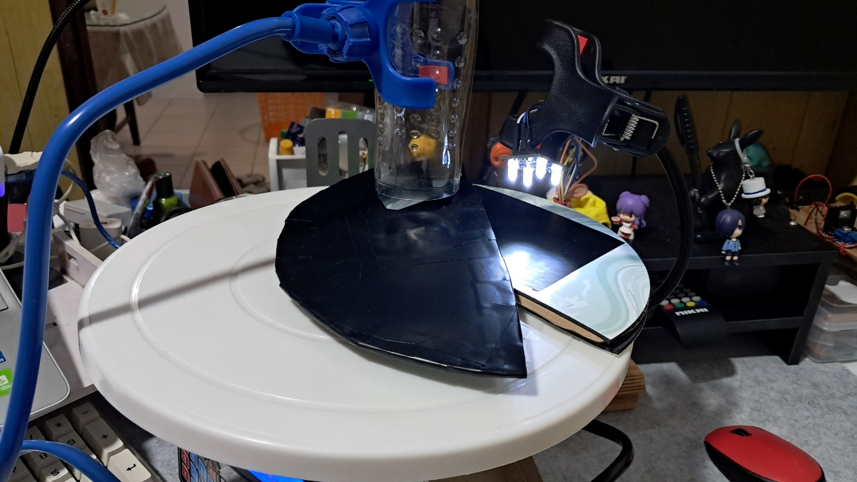
FINAL OUTPUT/PROTOTYPE DEMONSTRATION

Slide 14
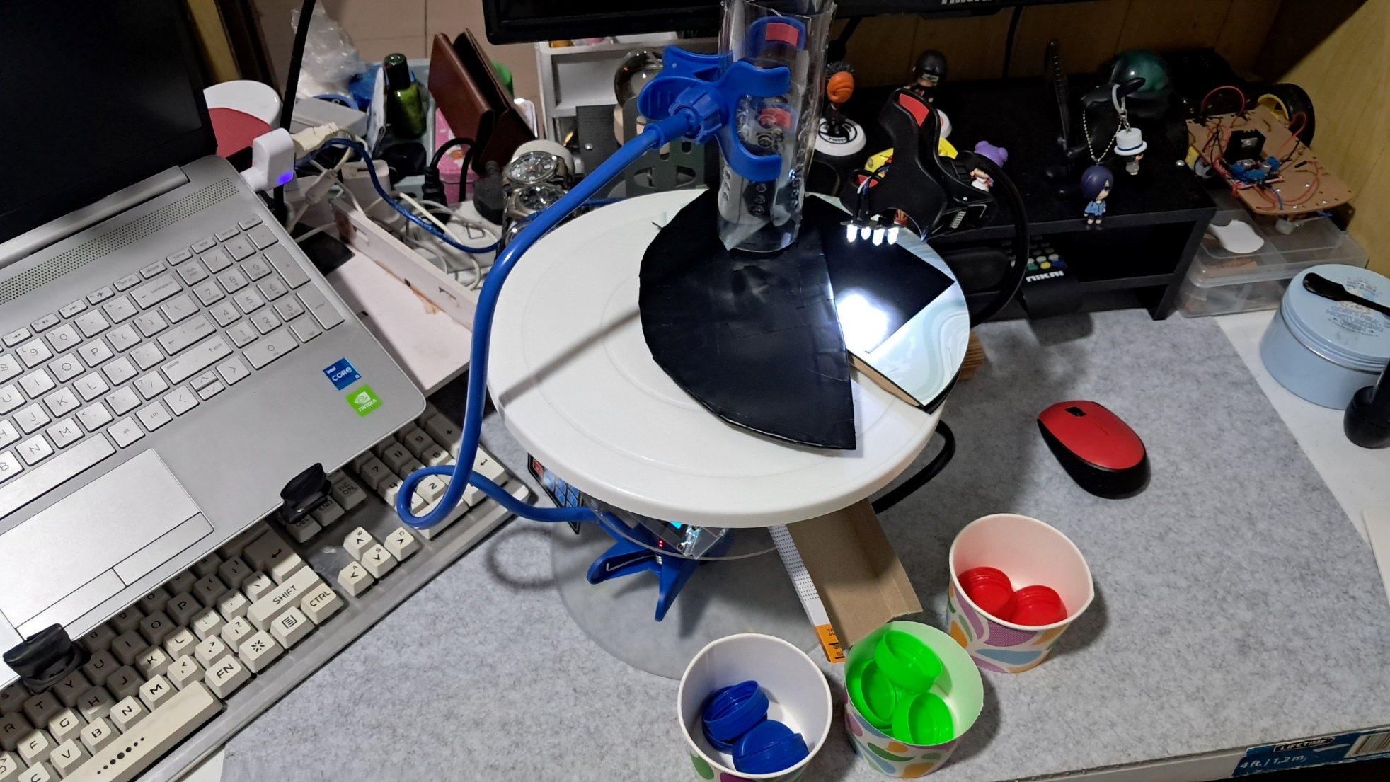
FINAL OUTPUT/PROTOTYPE DEMONSTRATION

Slide 15
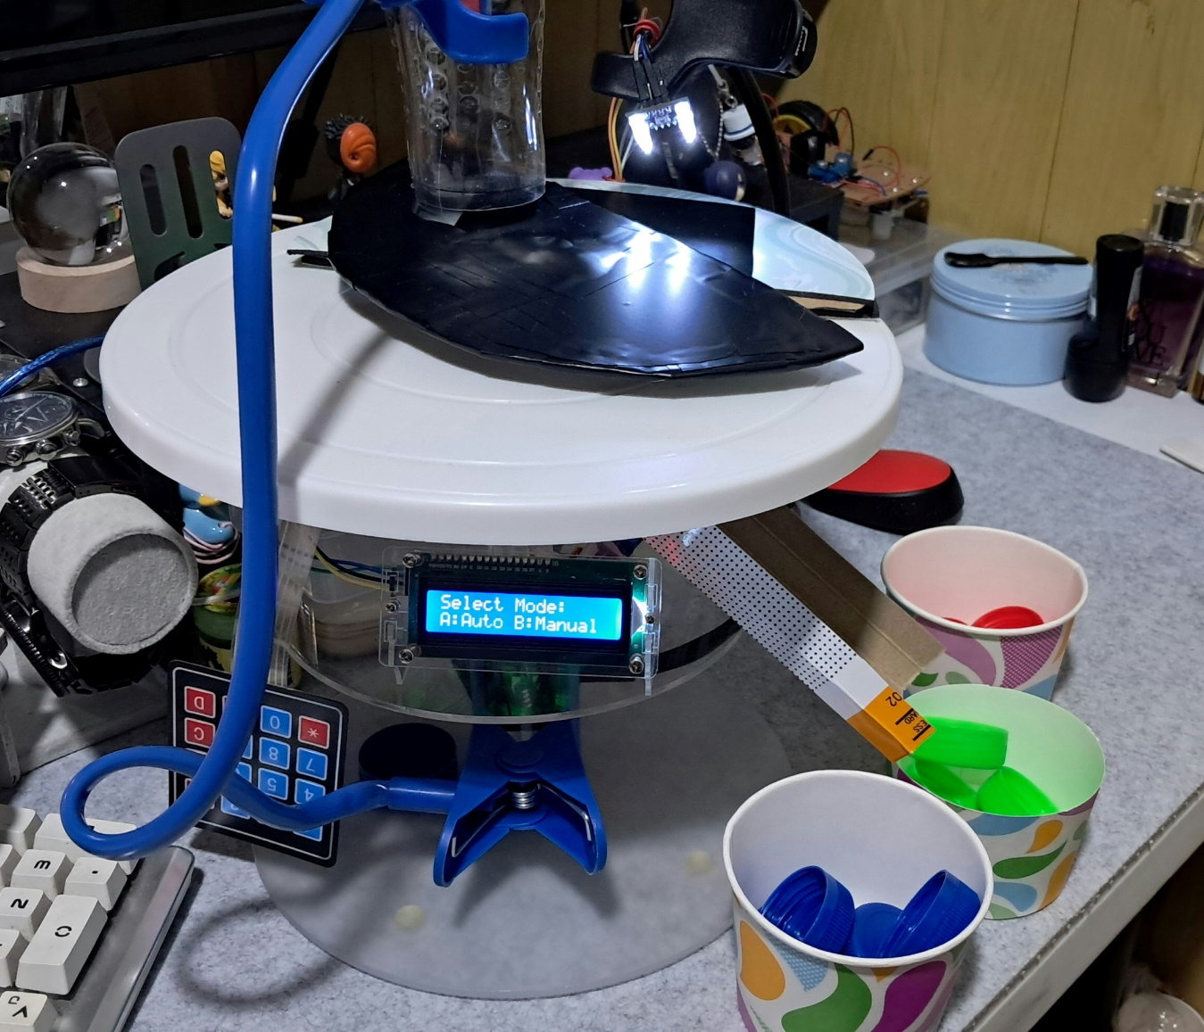
FINAL OUTPUT/PROTOTYPE DEMONSTRATION

Slide 16
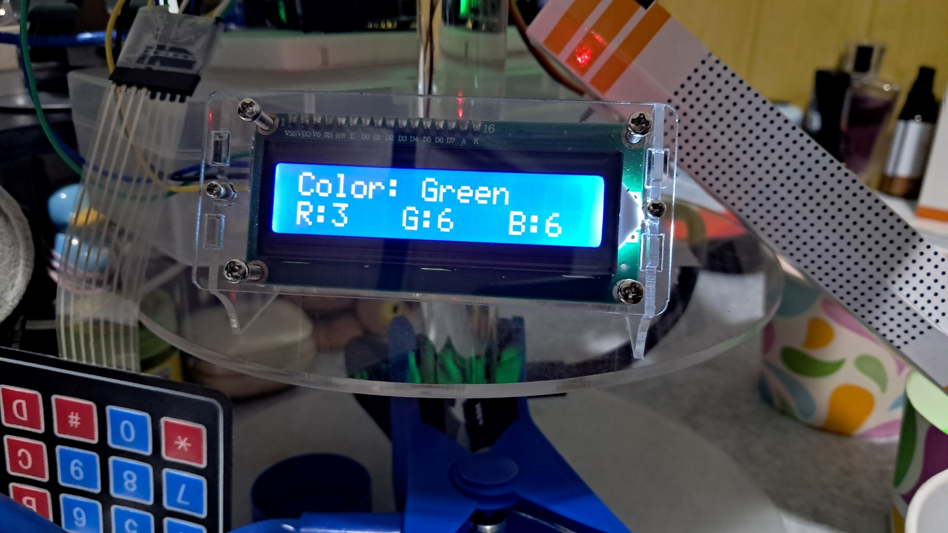
FINAL OUTPUT/PROTOTYPE DEMONSTRATION

Slide 17
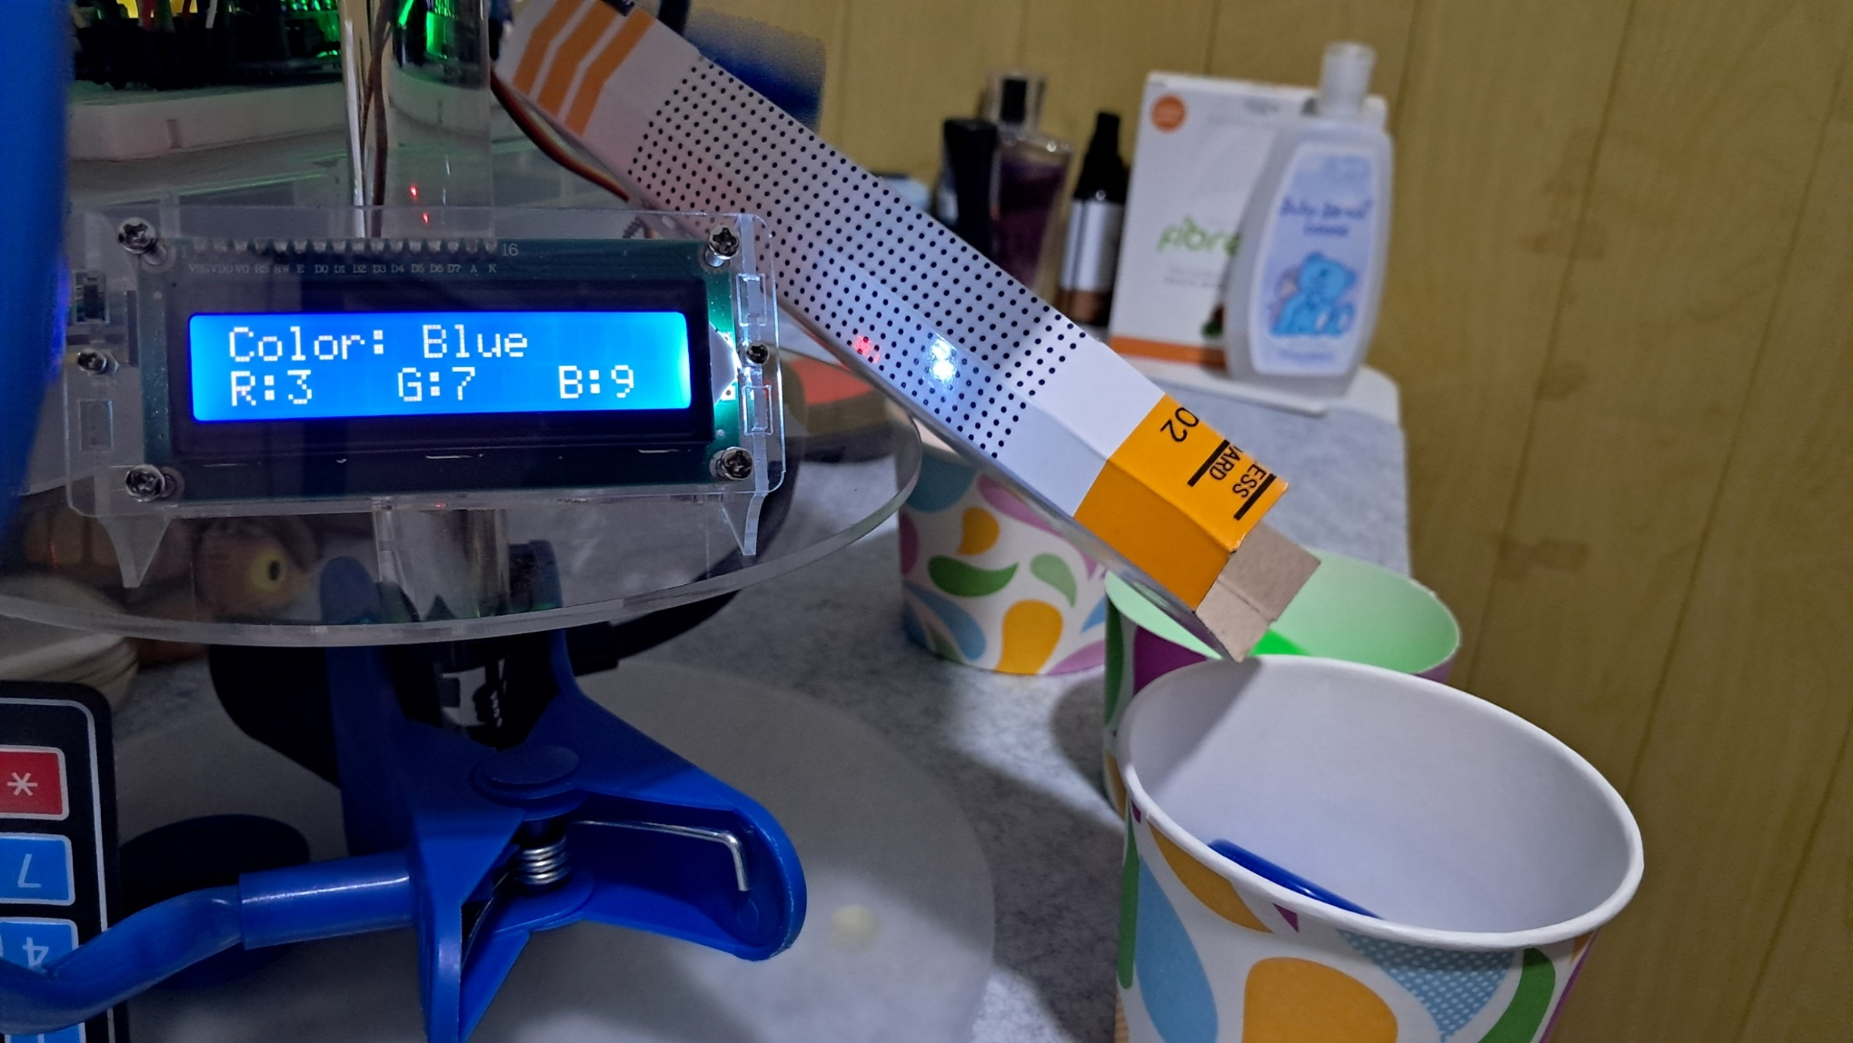
FINAL OUTPUT/PROTOTYPE DEMONSTRATION

Slide 18
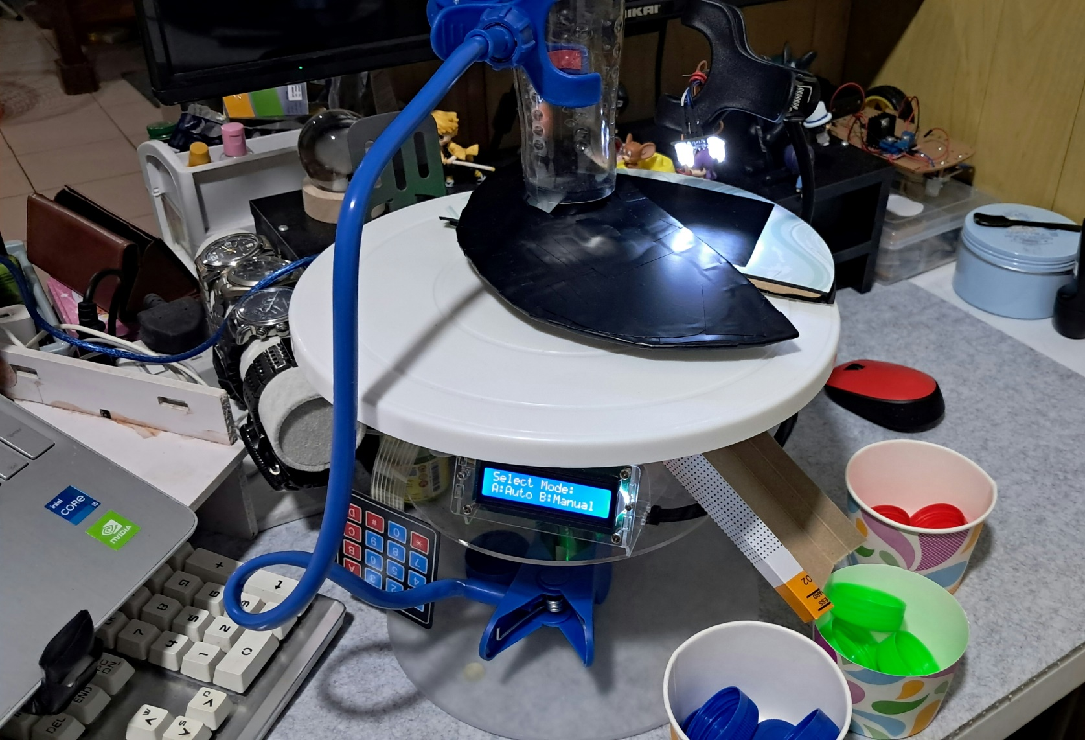
FINAL OUTPUT/PROTOTYPE DEMONSTRATION

Slide 19
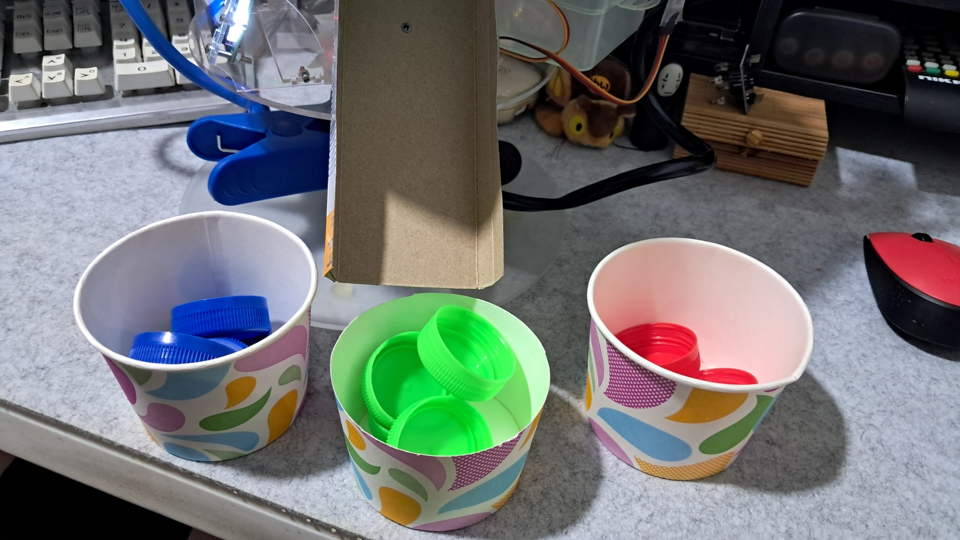
FINAL OUTPUT/PROTOTYPE DEMONSTRATION

Slide 20
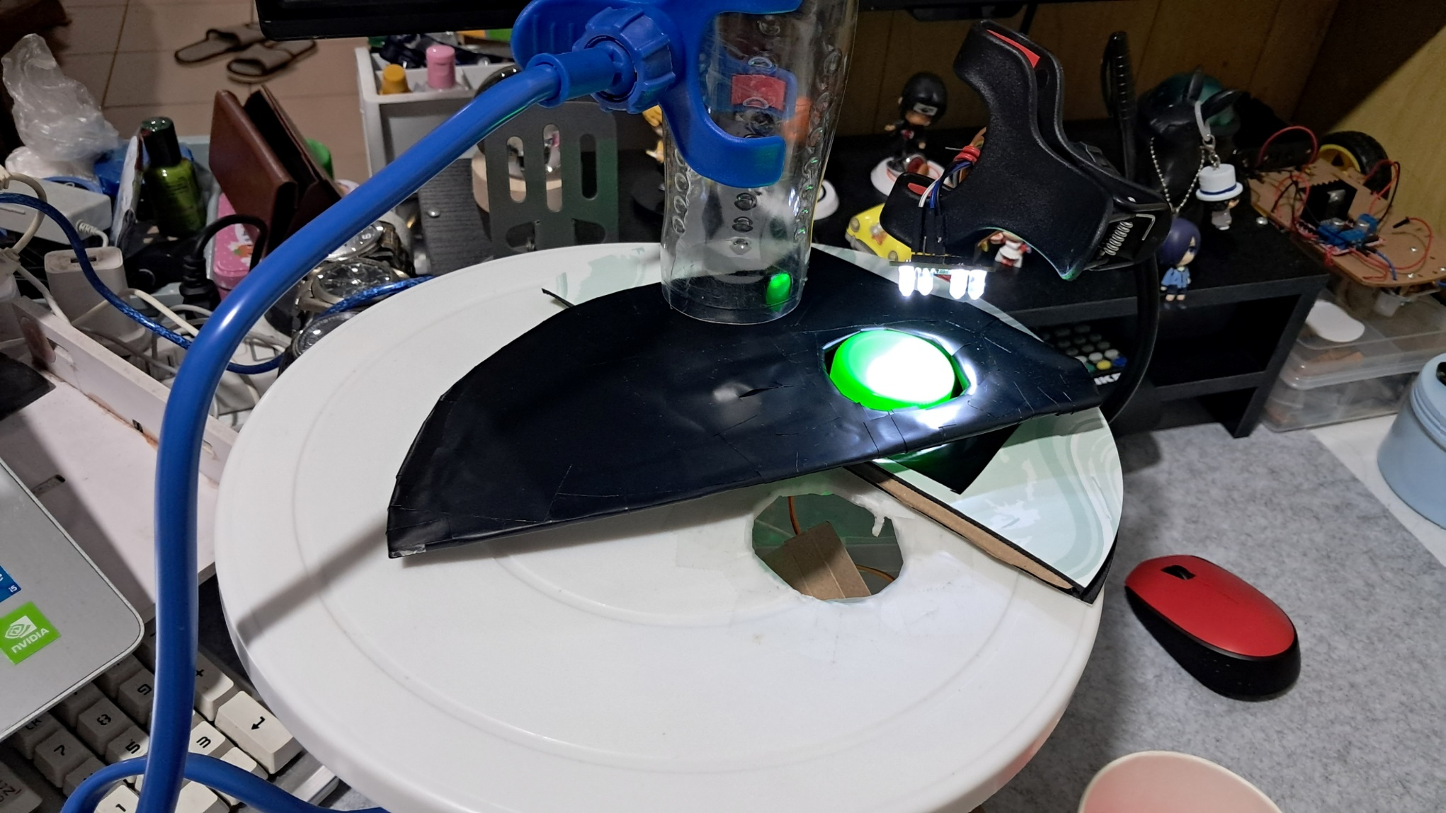
FINAL OUTPUT/PROTOTYPE DEMONSTRATION

Slide 21
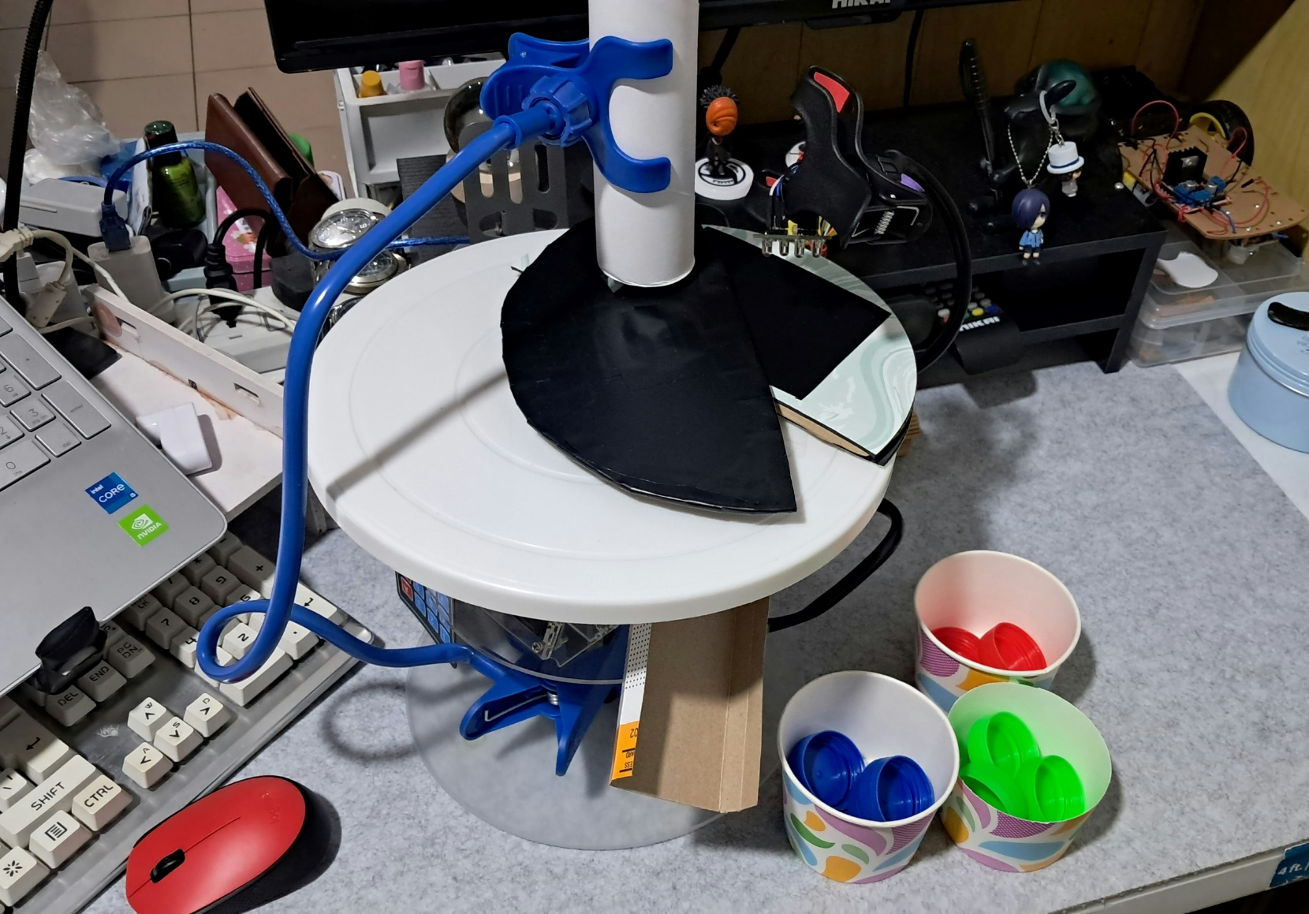
FINAL OUTPUT/PROTOTYPE DEMONSTRATION

Slide 22
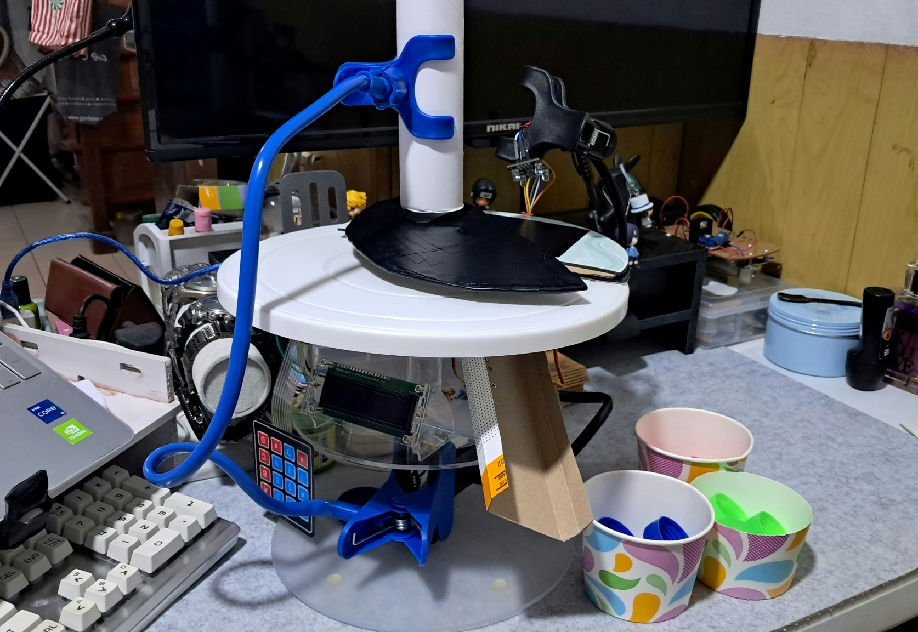
FINAL OUTPUT/PROTOTYPE DEMONSTRATION

Slide 23
THANK YOU!

